Slide 1

HackerEarth RAG Application – Sprint 1
Ethan Villalovoz, Molly Iverson, Adam Shtrikman, Chandler Juego

Slide 2
Introduction
We will develop a RAG (Retrieval-Augmented Generation) application for HackerEarth that will utilize vector search, knowledge graphs, and a LLM to answer questions and generate content from a knowledge base of more than 10,000 Wikipedia articles.

Slide 3
Sprint Objectives
Collect client requirements
Create user stories, use cases, and UML diagrams for the RAG application
Identify the necessary RAG application tools and full-stack frameworks, and begin learning

Slide 4
Requirements Gathering Process
Three client meetings:
9/10: Introduction Meeting
9/24: Report feedback, dataset questions, best use of RAG apps
10/1: Report feedback, tech stack recommendations
Techniques for gathering requirements:
Stakeholder meetings
Observation/research of current RAG apps
Project abstract

Slide 5
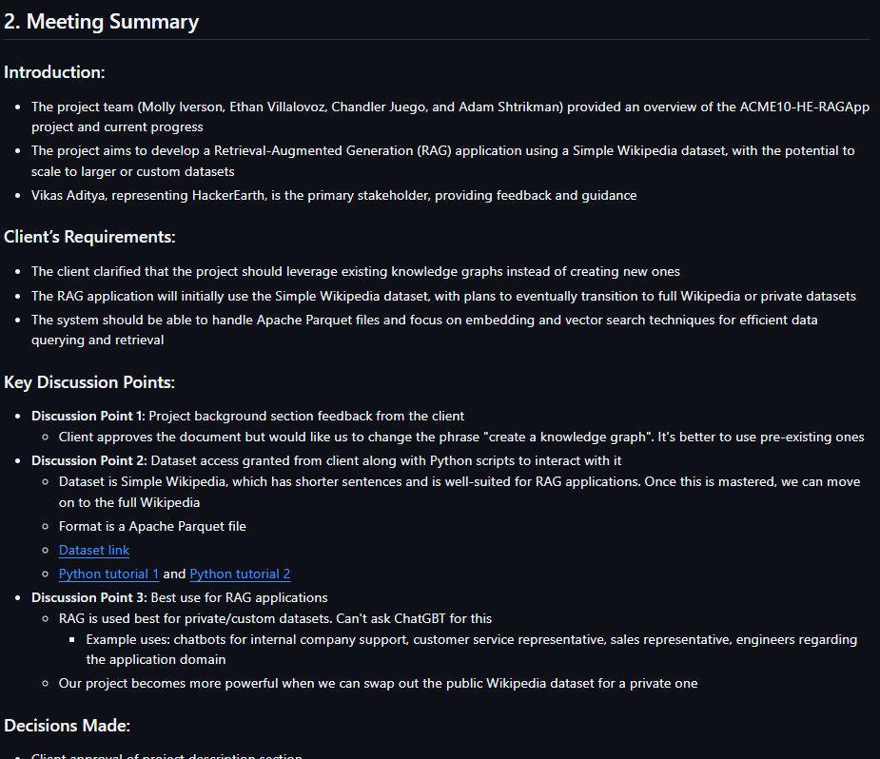
Meeting Notes 9/24

Slide 6
Requirements
RAG Architecture: Combine retrieval and generation to improve how responses are produced.
Knowledge Graphs: Use DBpedia and SPARQL to organize and access structured knowledge.
Vector Search: Implement FAISS to quickly find relevant information.
Wikipedia Dataset: Work with over 10,000 Wikipedia articles to answer queries.
LLM Integration: Use LLaMA to generate responses that are both accurate and relevant.
Handling Queries: Accept user questions, fetch the right information, and generate accurate responses.
Final Presentation: Present the system’s performance and key takeaways.

Slide 7
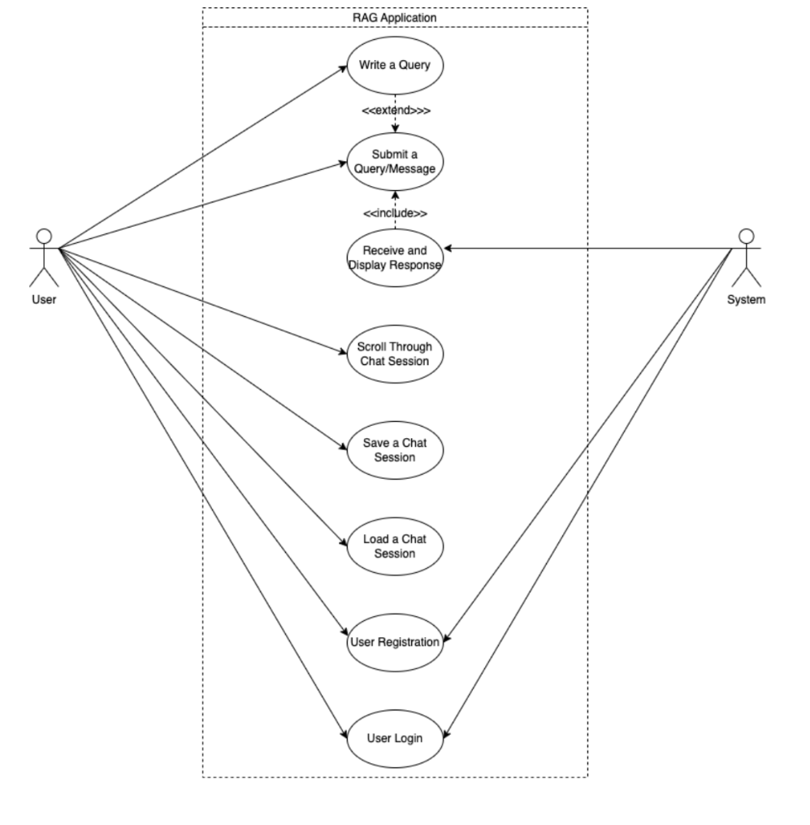
Documentation of User Stories, Use Cases, and UML Diagrams

Slide 8
Kanban Overview and Contributions
Summary:
Molly
Background and related work section
Functional requirements section
Knowledge Graph Python demo code
Ethan
Introduction section
Non-functional requirements section
Use case and activity diagrams
Chandler
Client and stakeholder information section
Use cases section
Sprint report
Adam
Project overview section
System evolution section
User stories document
All
Learning new skills and completing online courses
Meeting notes for client meetings

Slide 9
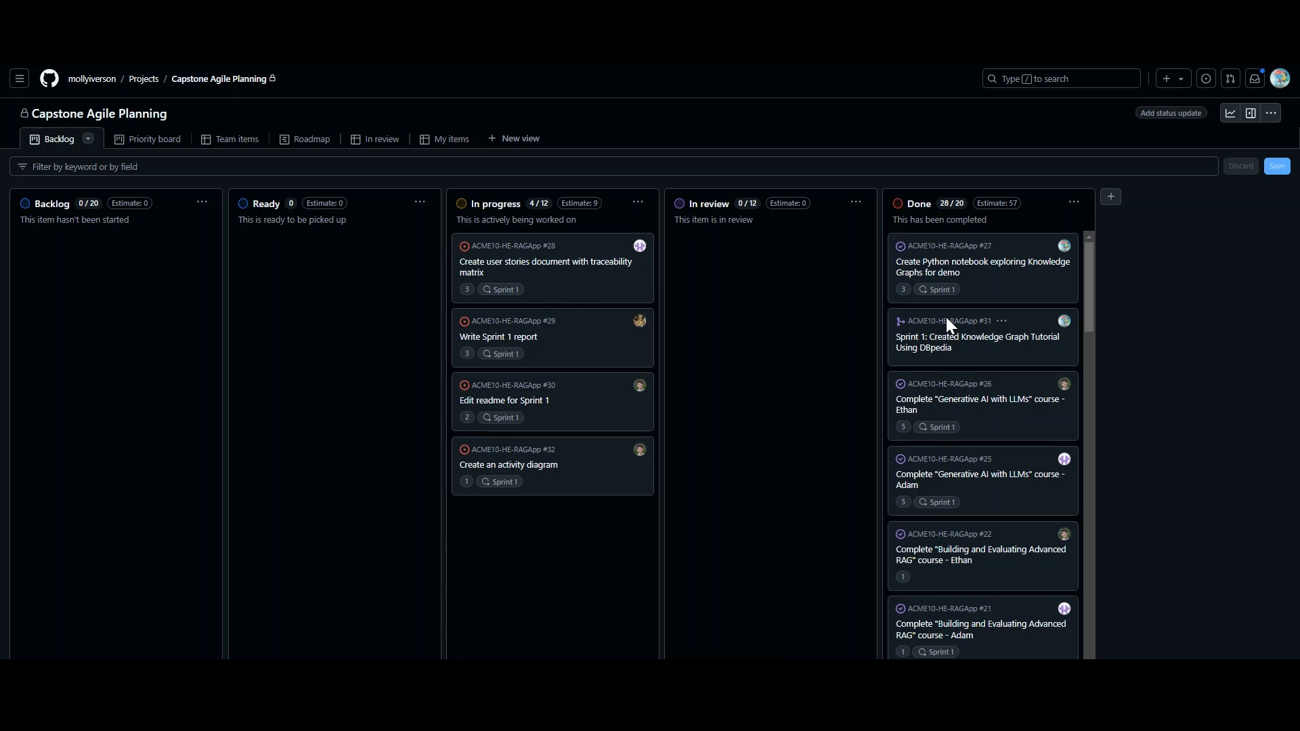

Slide 10
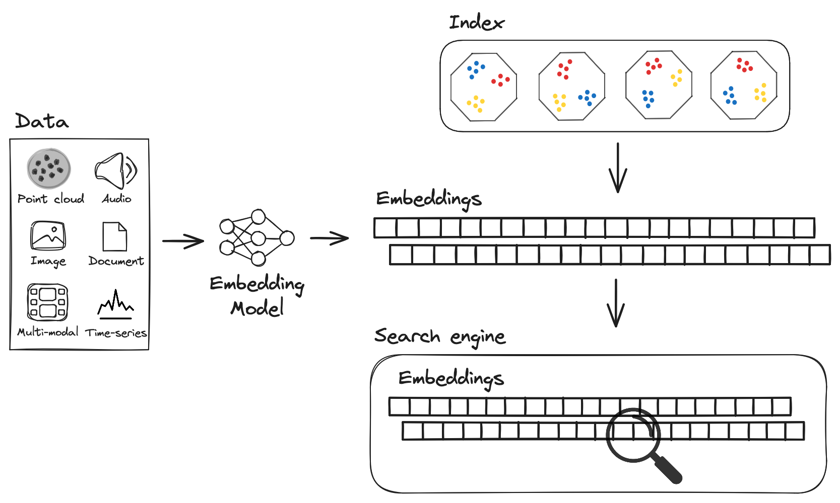


Skills Identification and Learning
Vector Search and Knowledge Graphs
VS: BERT for embedding, FAISS (Facebook AI Similarity Search) for search
KG: DBPedia, queried using SPARQL
LLM (Response Generation): LLaMA
Front-End Development:
React library
Back-End Development:
FastAPI for RESTful APIs in Python

Slide 11
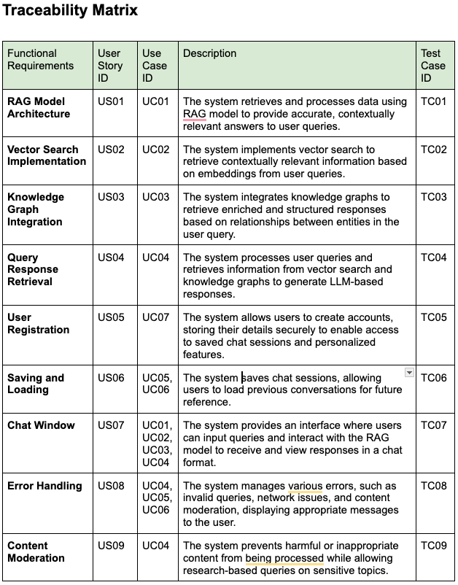
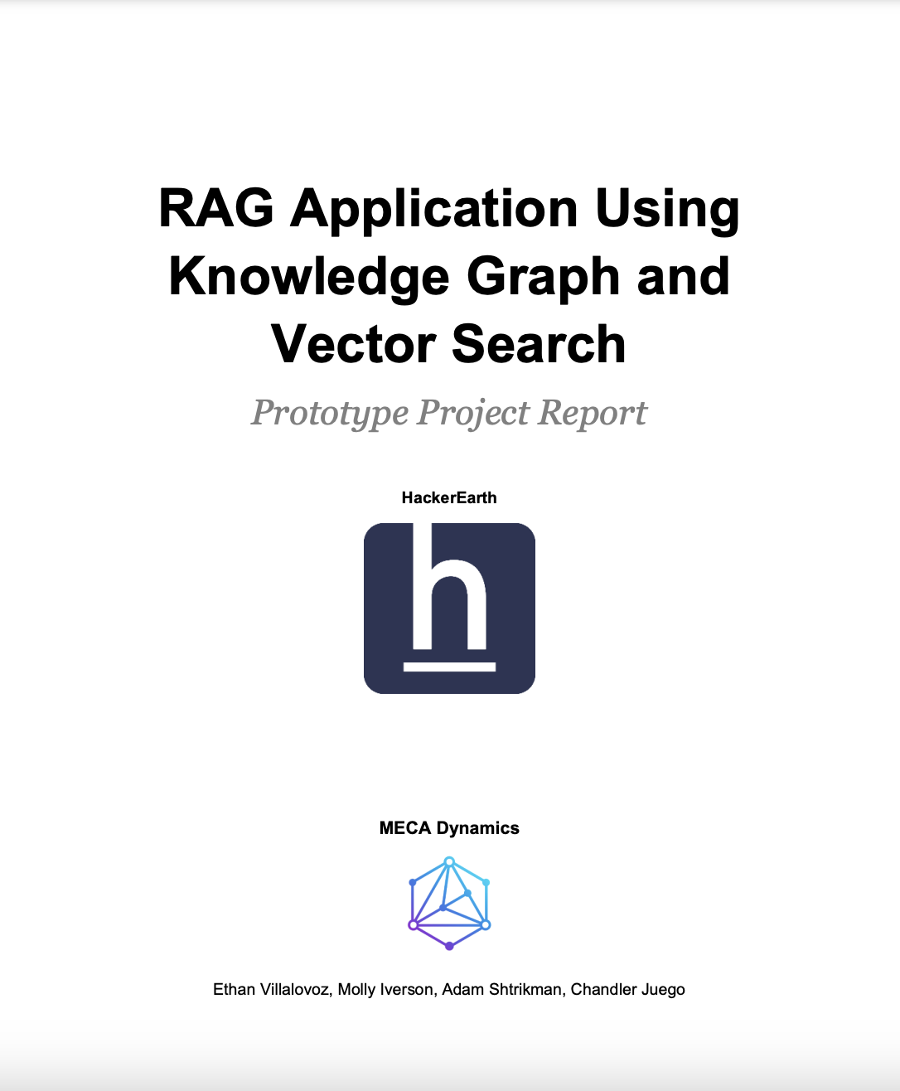
Sprint Achievements and Challenges
Looking back on Sprint 1.
Req. Gathering, Client Meetings, Documentation, Technical Learning, Project Report

Slide 12
Next Steps and Retrospectives
Looking towards Sprint 2.
Develop detailed system overview
Create architecture, data, and user interface design
Code a prototype
Continue client meetings and project report

Slide 13
Conclusion
Sprint 1 Achievements:
Collected and analyzed client requirements
Completed user stories, use cases, UML diagrams
Identified tools: Vector search, knowledge graphs, LLMs
Began learning necessary tech stack (React, FastAPI, FAISS)
Next Steps:
Develop system architecture and interface design
Start coding the prototype
Continue client meetings and feedback integration

Slide 14
Demo

